Slide 1

WordXML+ Extraction and Transformation Tool
User Guide
Software Version Release 1.3.3.
Lead developer / support: dawud.Rahman@aqovia.com / ioannis.selimas@pearson.com
5th October 2015

Slide 2
Contents
Introduction
Understand Word-XML format
Getting started with Word-XML+
1 - Login to the application
2 - Dashboard
3 - Upload your Microsoft documents
4 – Select Template Type
5 -Starting transformations
6 - Viewing new transformed documents
7 - Download XML documents
8 – Preview as XML and HTML
9 - Settings page - Define Specification Unit templates
10 - User Management

Slide 3



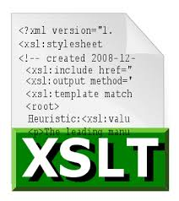
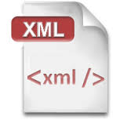



Introduction
WordXML+ is a Cloud software application which enables Pearson Qualification developers and writers to extract Btec Nationals and Btec Level 2 specification data authored in Microsoft Word documents as XML which is then ingested into the MyBTEC product. The application is built on the open source DocX4J library and executes Xslt and Xquery scripts to generate IQS formatted XML required for the Pearson Edexcel course accreditation system (PQS).
What it does
This application replaces the manual outsourced process handled by Aptara to convert Btec specification MS Word documents into IQS XML. In absence of a long term strategic system this application is an interim solution to address this need for automated and bulk extraction, which represent a significant cost saving to Pearson Qualification department.
How Word-XML+ Works
1 - Extraction
Btec Specifications are authored in Microsoft Word documents based on Word templates with tagged XML section using Word’s advanced design mode feature. Content is extracted as OpenXML format directly from Word Documents.
2 - Transformation
OpenXML data is filtered and transformed into Word-XML format - This a concise format capturing qualification units data. Conversion to PQS format is supported for Pearson Qualification System ingestion
3 – Merging and conversion to print & digital formats
Word-XML is combined with front and back matter and converted into other formats for use in other systems for print and digital workflow. (Proposed functionality -available in Phase 2 3rd quarter 2015)

Slide 4
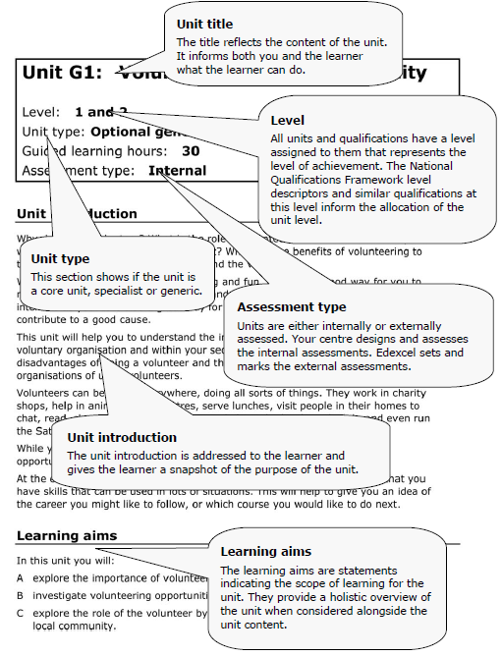
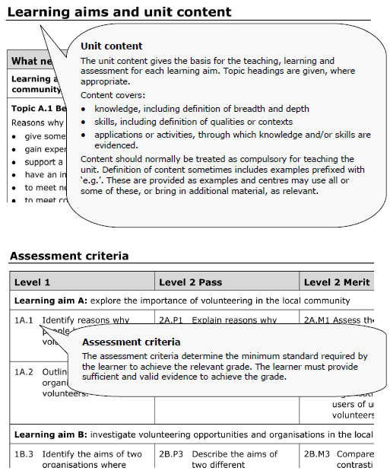
Understanding the Word-XML format
In the Transformation stage the default rules (as supplied in the Xquery and XSLT scripts, configured in the application settings page) parse the extracted OpenXML to pick out the sections and Meta data illustrated below.
<unit>
<uan>H/123/1234</uan>
<unitnumber>44</unitnumber>
<unittitle>Manufacturing Secondary
Machining Processes</unittitle>
<level>3</level>
<unittype>Optional</unittype>
<glhvalue>60</glhvalue>
Metadata
Section > Paragraph
<section title="Unit introduction" style="UnitAhead">
CONTENT PARAGRAPH as text
</section>
Section
<section title="Learning aims" style="UnitAhead">
CONTENT as LearningObjective Nodes
</section>
Section > Table
<section title="Learning aims and unit content" style="UnitAhead">CONTENT as TABLE
</section>
Section > Table
<section title="Assessment criteria" style="UnitAhead">
CONTENT as TABLE
</section>
Continued….

Slide 5
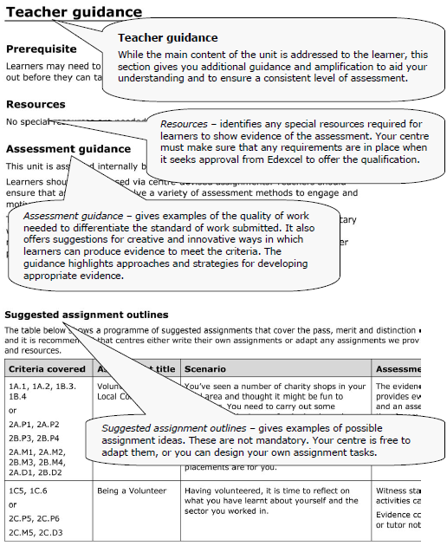
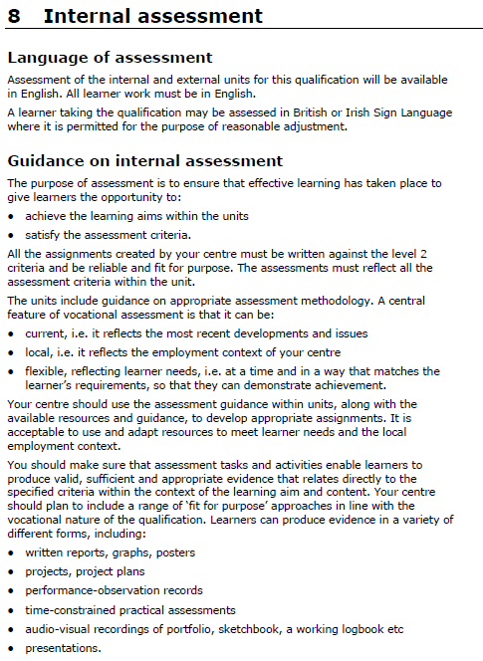
Understanding the Word-XML format (Continued…)
In the Transformation stage the default rules (as supplied in the Xquery and XSLT scripts, configured in the application settings page) parse the extracted OpenXML to pick out the sections and Meta data illustrated below.
Section > Section > Paragraph or TABLE
<section title="Teacher guidance" style="UnitAhead" >
</section>
<section title="Resources" style="UnitBhead">
CONTENT as PARAGRAPGH Nodes
</section>
<section title="Assessment Guidance" style="UnitBhead">
CONTENT as PARAGRAPGH Nodes
</section>
<section title="Resources" style="UnitBhead">
CONTENT as PARAGRAPGH Nodes
</section>
<section title=" Suggested Outline Assignments" style="UnitAhead">
CONTENT as TABLE
</section>
Section > Section > Paragraph
<section title="Teacher guidance" style="UnitAhead" >
</section>
<section title="Assessment criteria" style="UnitAhead">
CONTENT as PARAGRAPGH Nodes
</section>
<section title="Assessment criteria" style="UnitAhead">
CONTENT as PARAGRAPGH Nodes
</section>
</unit>

Slide 6
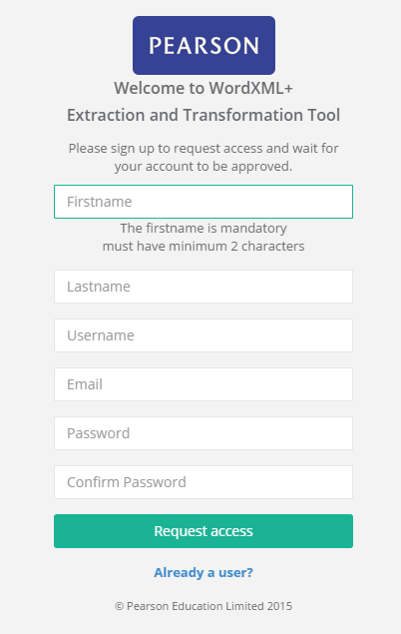
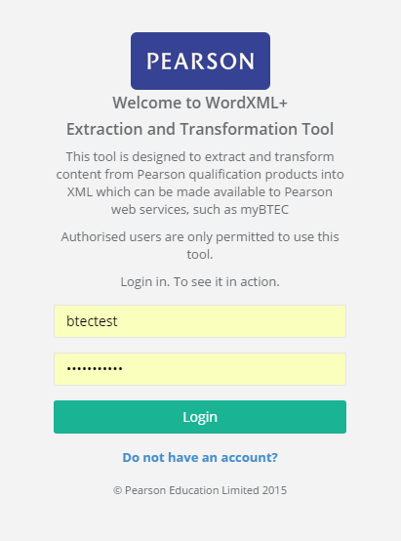
Getting started with Word-XML+
1 Login to the application
The application is host on the cloud:
http://wordxmltool.elasticbeanstalk.com/public/login.html
Sign up for a login account if you don’t already have an account setup.
Once approved by your Qualification Development Team leader, sign in.
For Administrator – see the section guide on User Management.

Slide 7
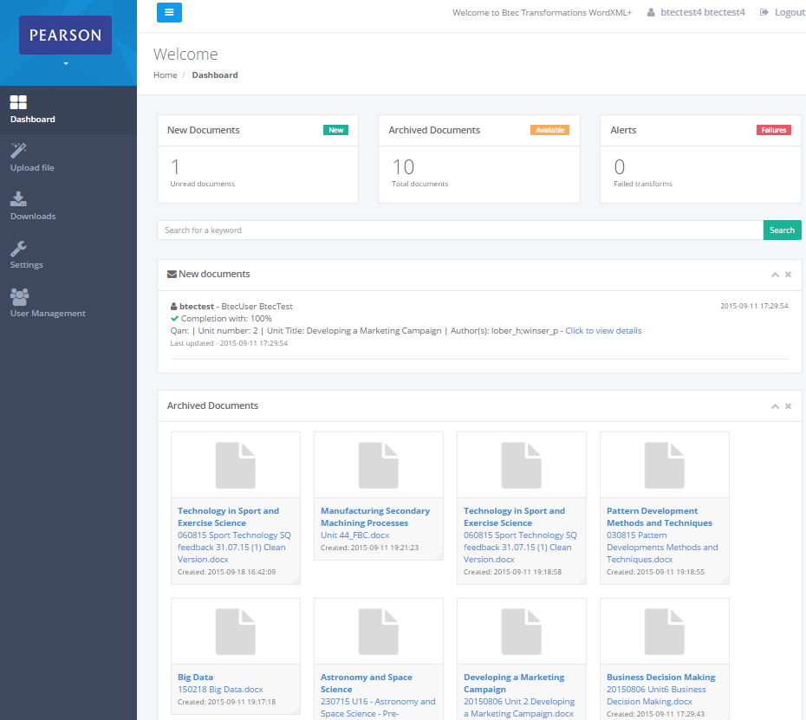
Getting started with Word-XML+
2 Dashboard
Upon login, this is the main page showing:
New unread documents that have been recently transformed and status.
Transformed Word-XML documents.
Summary statistics of transformed documents.
Left Hand Navigation is the common way to use the application:
Dashboard – this page
Upload file – upload and perform Word to XML file transformation
Downloads – completed transform documents are listed here
Settings – add Word document validation and xml tag filter rules
User Management – Administrators can manage users here.

Slide 8
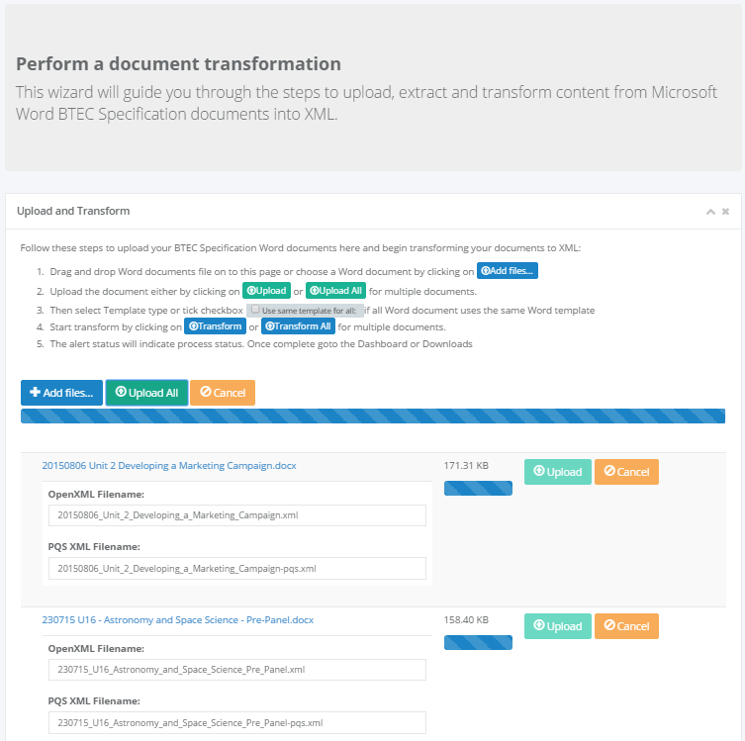
How to extract and transform your Btec Units using the Word-XML+ Tool
3 - Upload your Microsoft Word documents
Before uploading your Word documents – finalise your content by accepting all changes and turn change-tracking in Word.
Click on ‘Upload file’ tab in the left hand navigation to go to the file upload wizard.
Drag and drop your files onto the page or click on ‘Add files’ and add them to the list.
Click on ‘Upload ALL’ or ‘Upload’ to upload the files to the server. Wait until the progress bars have completed.

Slide 9
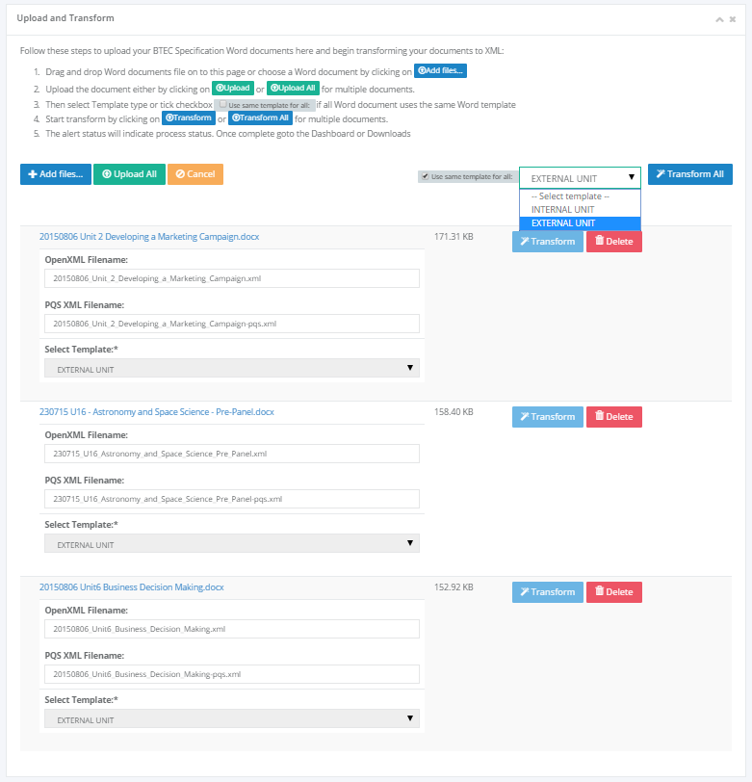
How to extract and transform your Btec Units using the Word-XML+ Tool
4 – Select Template Type
When file is uploaded is the ‘Transform’ button will be enabled.
Select the Template type for all the documents and enter UAN number and XML document filename.
Click on ‘Transform ALL’ or ‘Transform’ to upload the files to the server. The status message will appear when the document has transformed and the document will be cleared from the list.

Slide 10
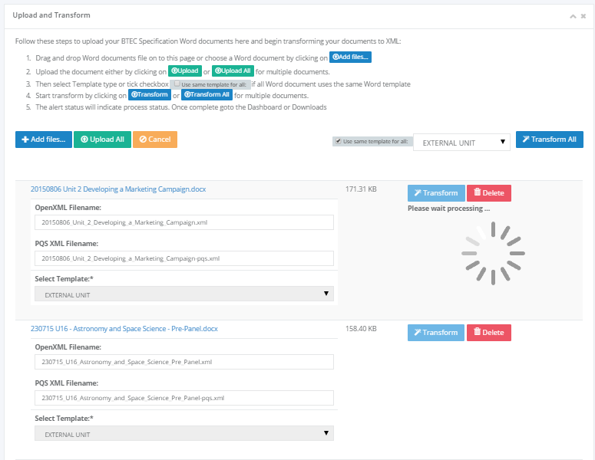
How to extract and transform your Btec Units using the Word-XML+ Tool
5 – Starting transformations
Each valid work document will be processed sequentially.
The process will come to a halt if there are errors. For failed documents, click ‘Delete’ and upload the correct Word document again.
Failed transformations will display with an error message. This could be due to either :-
Change tracking is present in document
Incorrect template type selected or document template has been modified.
Word file is corrupt or is not Word Docx format.
Check and correct the Word document and upload and transform again.

Slide 11
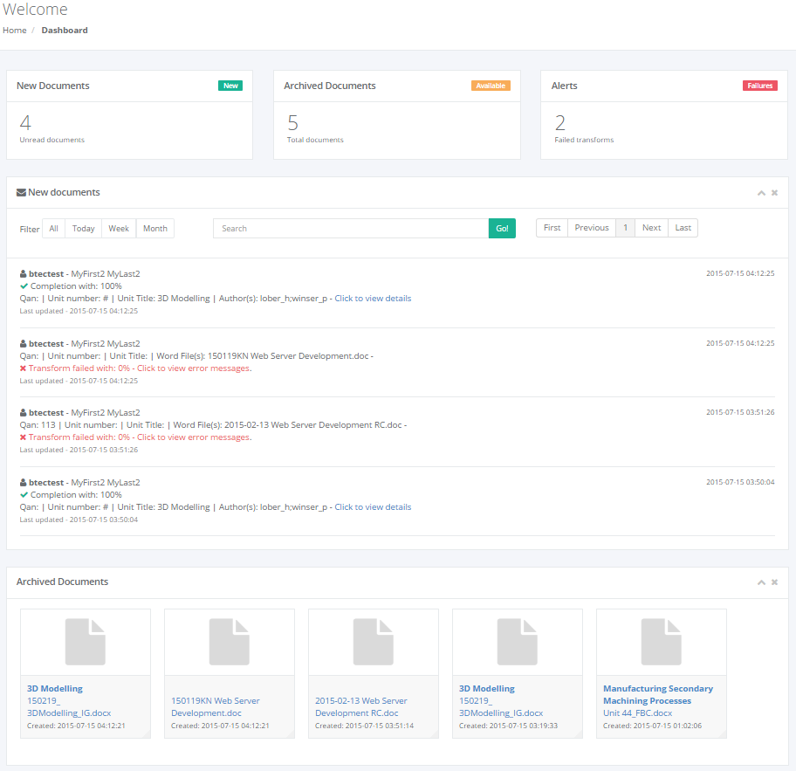
How to extract and transform your Btec Units using the Word-XML+ Tool
6 – Viewing new transformed documents
Click on the ‘Dashboard’ tab in the navigation to view the resulting transformed document.
For failed documents, go to the ‘Downloads’ tab and delete the selected document. Then go to the upload correct Word document again.
Recently transformed document will appear here, click on the link to view details of the transform. Once you view the document its status will change to ‘READ’ and will show up in the Archived documents.

Slide 12
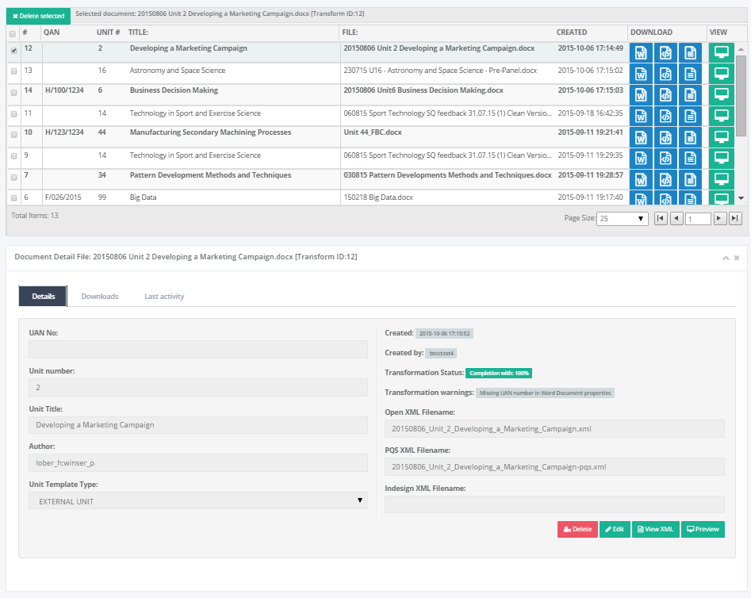
How to extract and transform your Btec Units using the Word-XML+ Tool
Download as
Indesign XML format (proposed - available 3rd quarter 2015)
PQS-XML format
Word-XML format
Original Word Doc
Preview
as HTML
7 – Download XML documents
Click on ‘Downloads’ tab in the navigation to go to the list of XML file downloads.
Successfully transformed document will have their UAN, Unit No, Title listed here.
Document’s details such as UAN, Unit No, Unit Title and Author can be updated by clicking on ‘Edit’.
Multiple documents can be deleted from the system by selecting the checkbox and clicking on ‘Delete Selected’
Tabs below shows:-
Transformation details – the XML filename can be changed and will be downloaded as specified. The UAN number can be entered. All changes are automatically saved.
List of available downloads – will list all the formats. The XML document will instantly generate upon download.
Last Activity – this maintain an audit trail of edits, reviews, comments made to the XML content via the editor (available 3rd quarter 2015)
Preview as XML
Preview as HTML

Slide 13
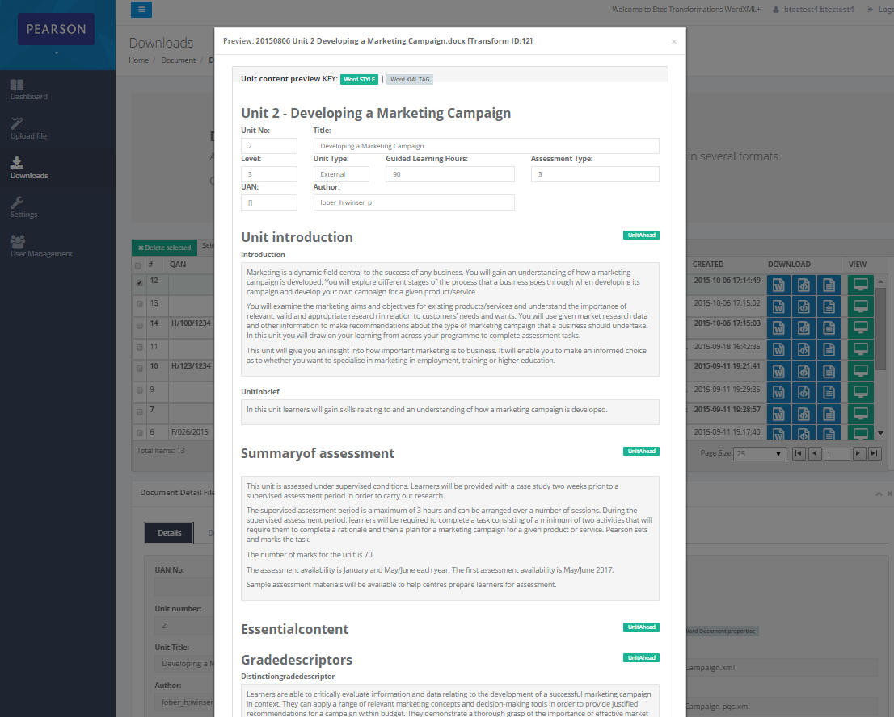
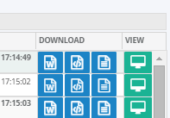
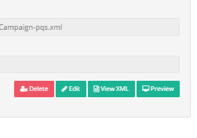
How to extract and transform your Btec Units using the Word-XML+ Tool
8 – Preview as XML and HTML
On ‘Downloads’ page in the ‘Details’ tab and list is the ‘Preview’ button. This will open a page to display a HTML rendered preview and an XML preview of the document.
Preview

Slide 14
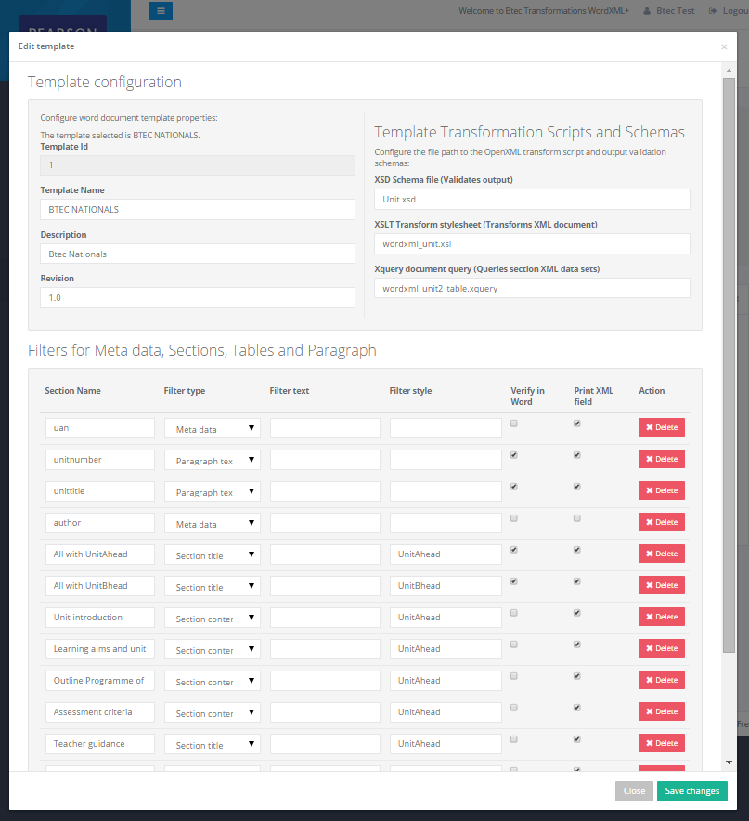
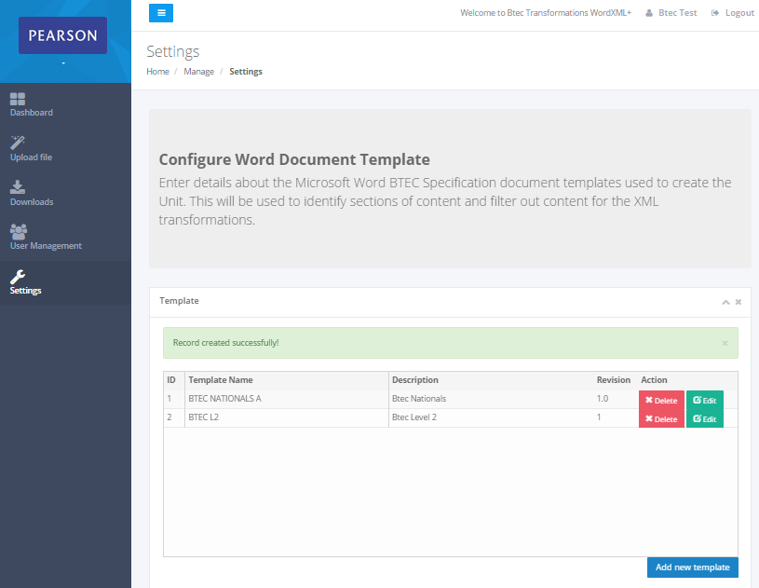
How to extract and transform your Btec Units using the Word-XML+ Tool
9 – Settings page - Define Specification Unit templates
Click on ‘Settings’ tab in the navigation to go to the setting pages.
Word-XML tool needs to know what XML tagged content is expect in the Word document. This populates the dropdown list for Template type in the Upload file page.
To add a template click on ‘Add new template’ or ‘Edit’. Add the Sections that you would like to validate on and extract to the Word-XML output file. Here’s what the Template field means :-
Section name – define a name for this content rule.
Filter type – state what type of section this is.
Filter text – search for a text i.e Title
Filter style – search for Word formatting style i.e UnitAHead,
UnitBHead
Verify in Word – validates this field in Word document.
Print XML field – if none are select then all the XML tagged
content will be output to the Word-XML file.

Slide 15
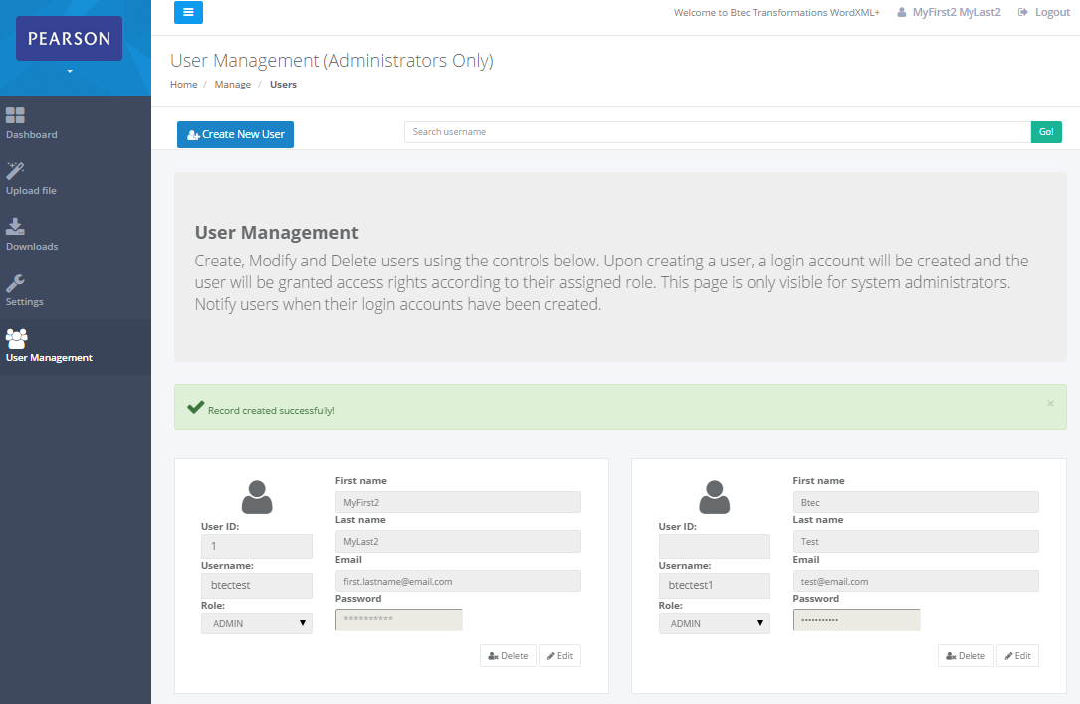
How to extract and transform your Btec Units using the Word-XML+ Tool
10 – User Management – for users with Admin Role only
Click on ‘User Management’ tab in the navigation to go to the user management pages.
New users are created from the sign-up link on the login page.
The new user account will need to be approved by the Qualification Development Team leader and assigned a Role. This can be either Admin, Editor, Author or Viewer only.
Once assigned a role the user can login. The login account is different from the Pearson cloud login. This is so that temporary accounts for freelancers and temporary staff can be created quickly.
Each user account will maintain an audit trail which is recorded in the Cloud server logs for monitoring the applications and identifying causes of system errors.

